Slide 1
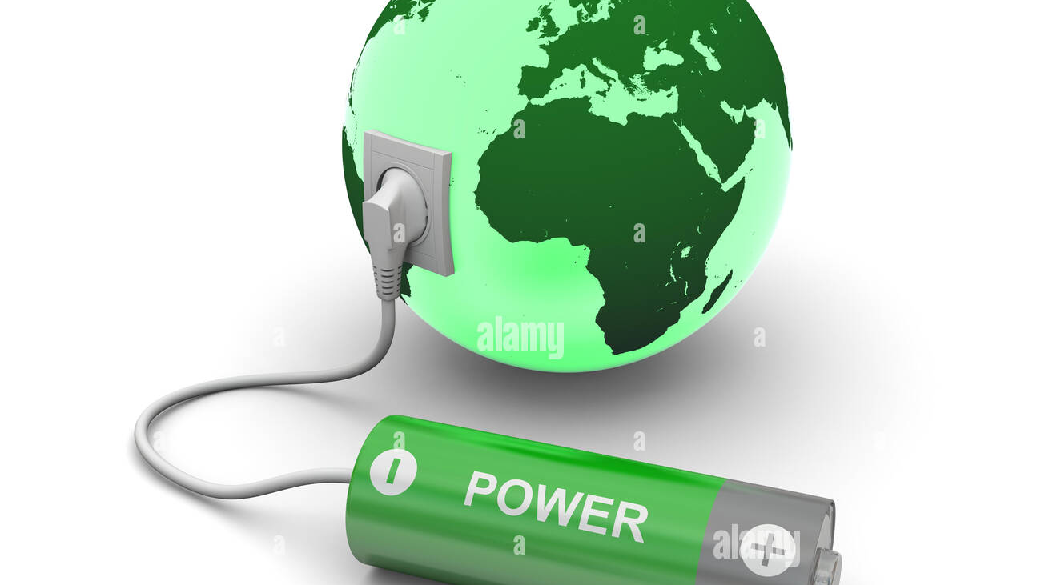
Using the Earth as a battery

Slide 2
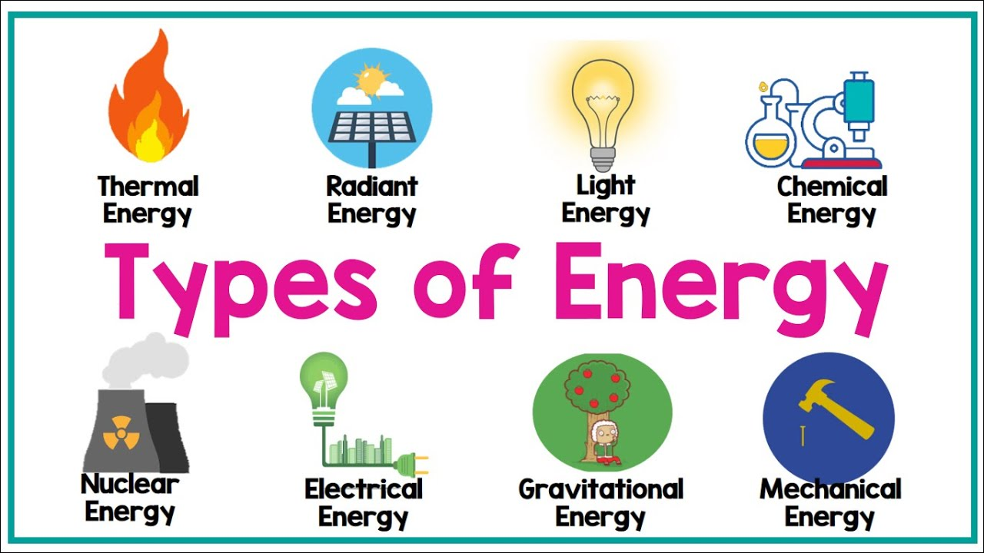
What are the different
?

Slide 4

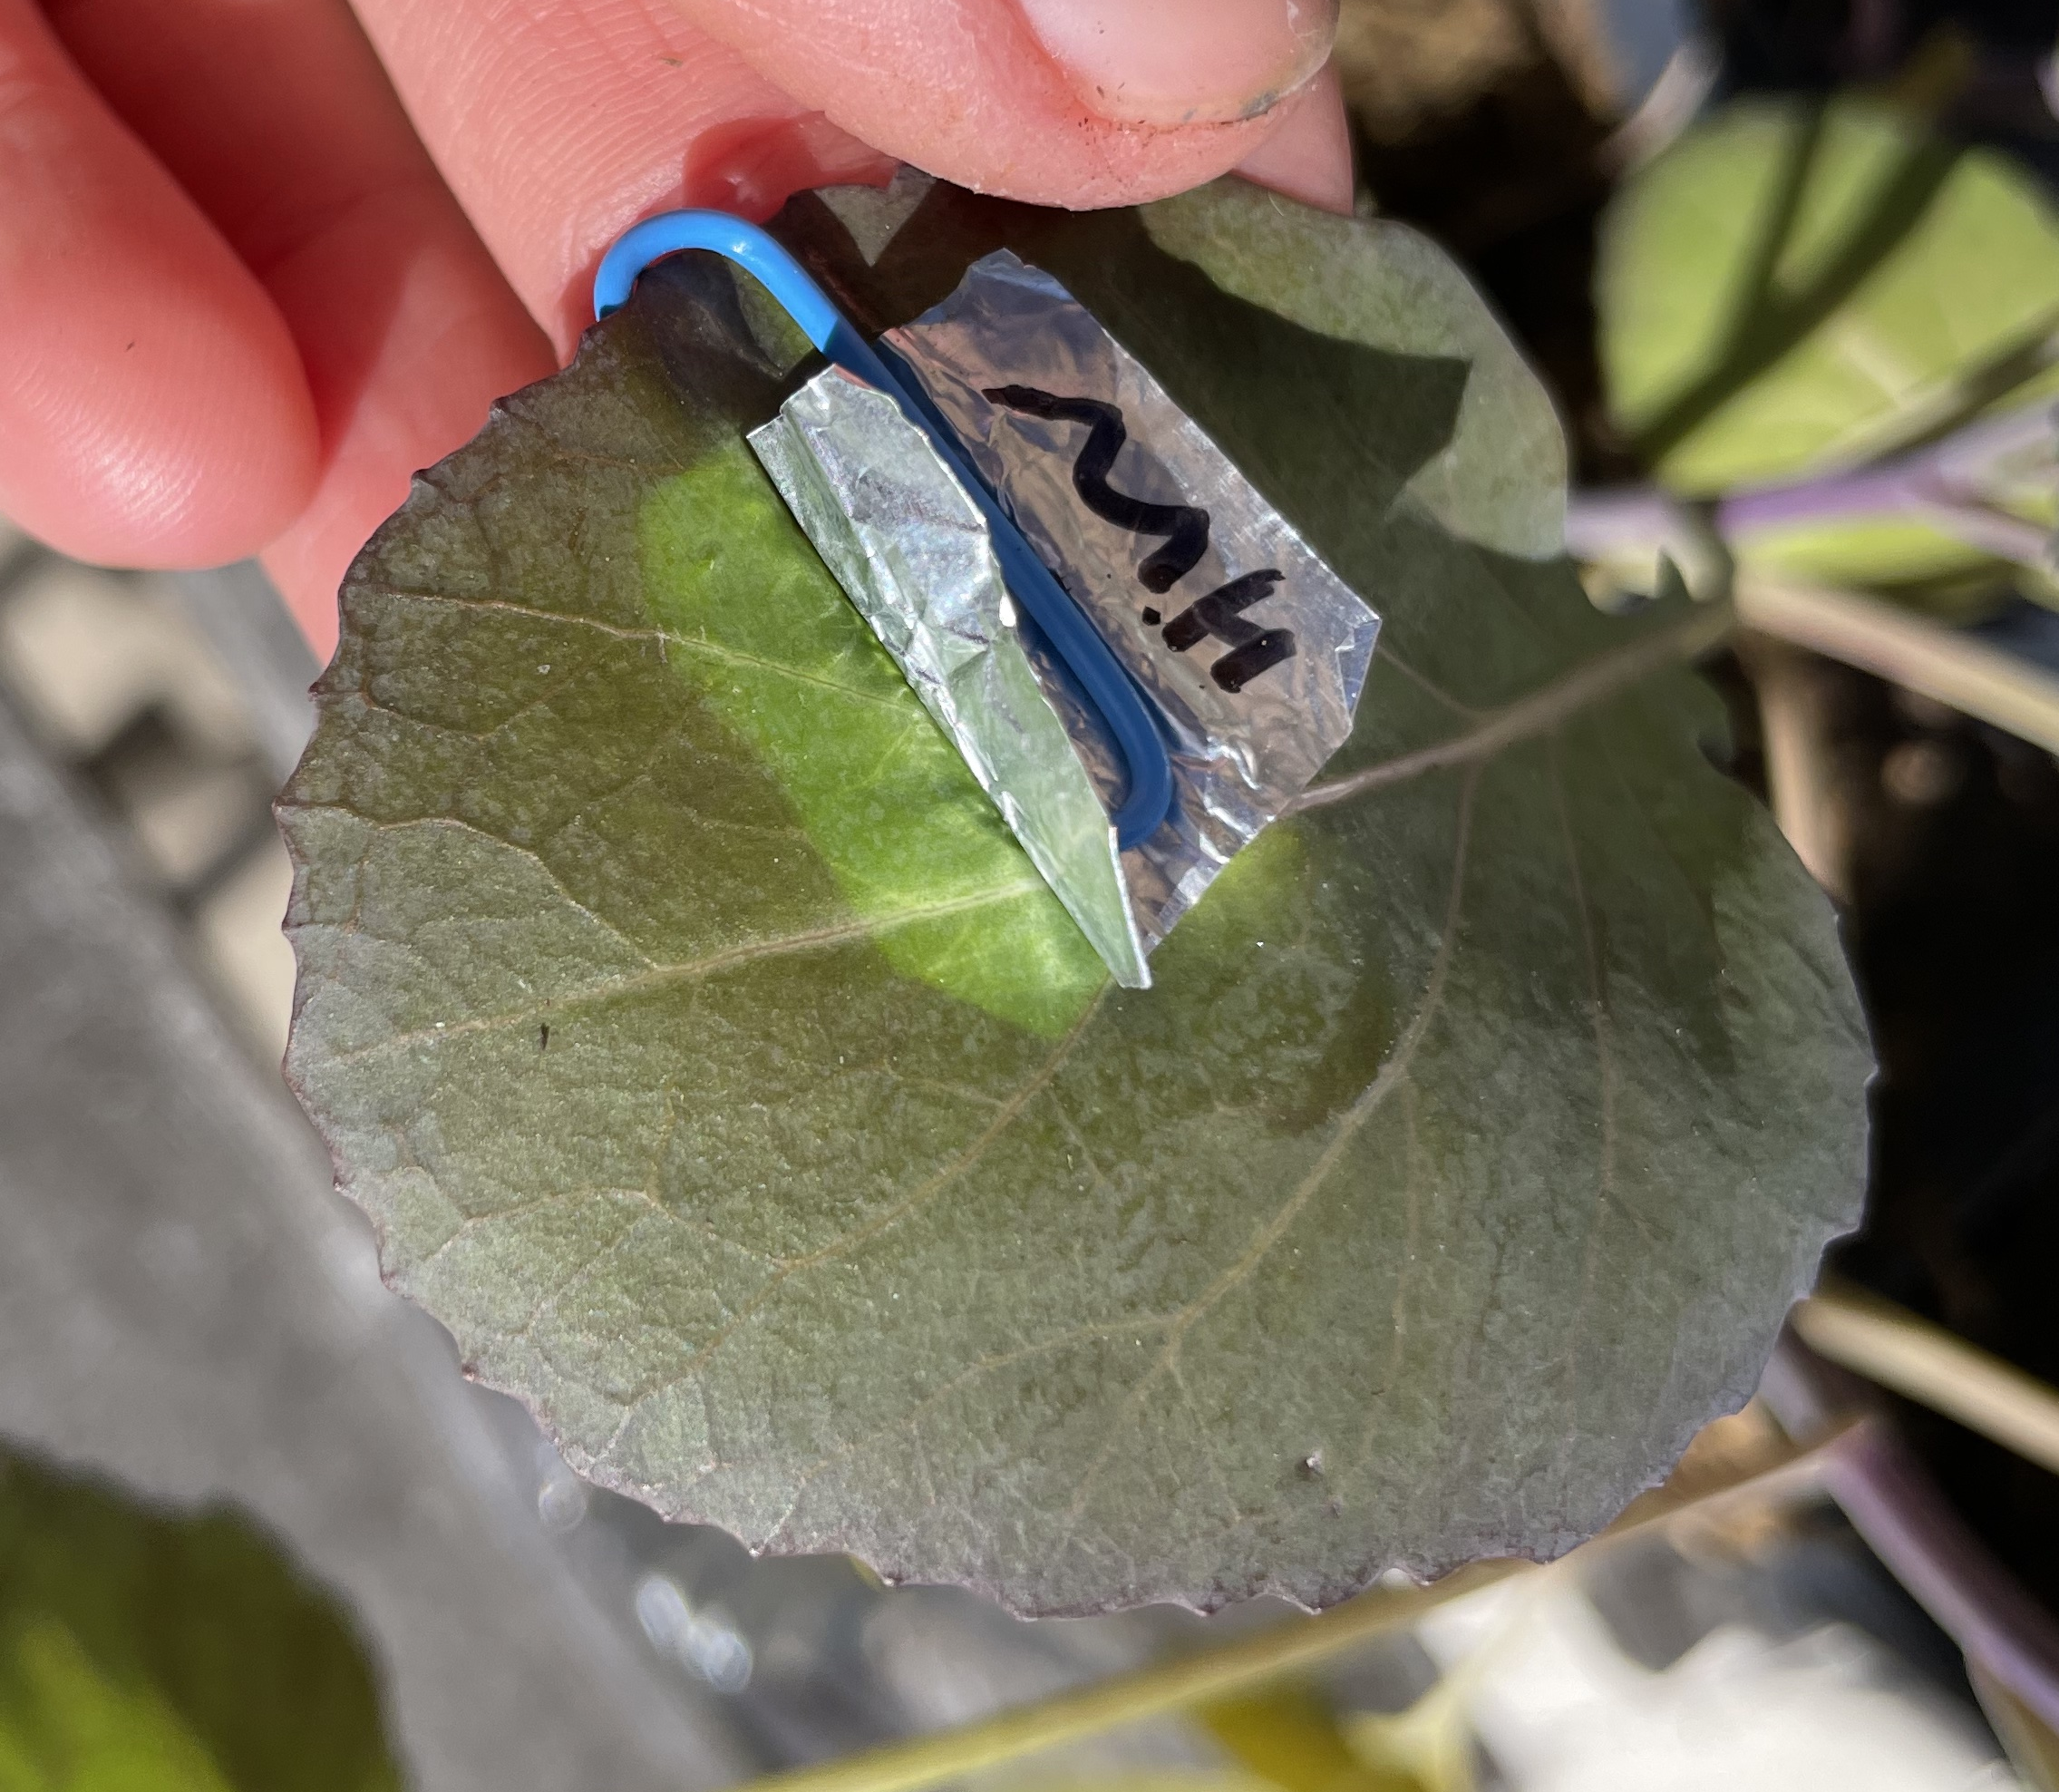
Plants convert light energy into chemical energy

Slide 5
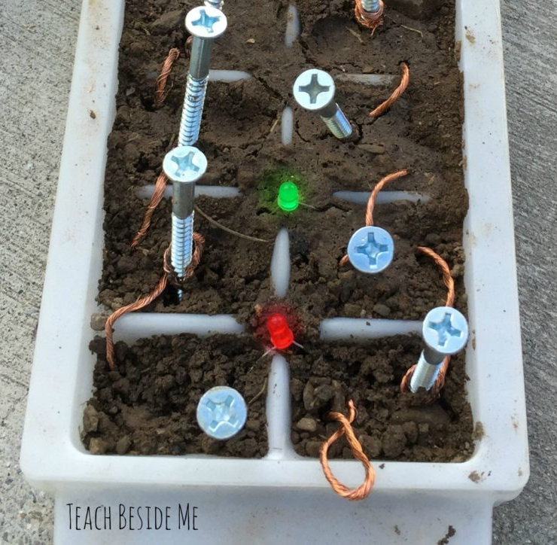
Today we will use chemical energy stored in soils to make electricity and light energy.
This is a soil battery!

Slide 6
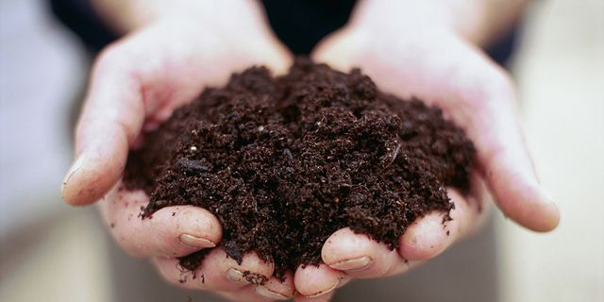
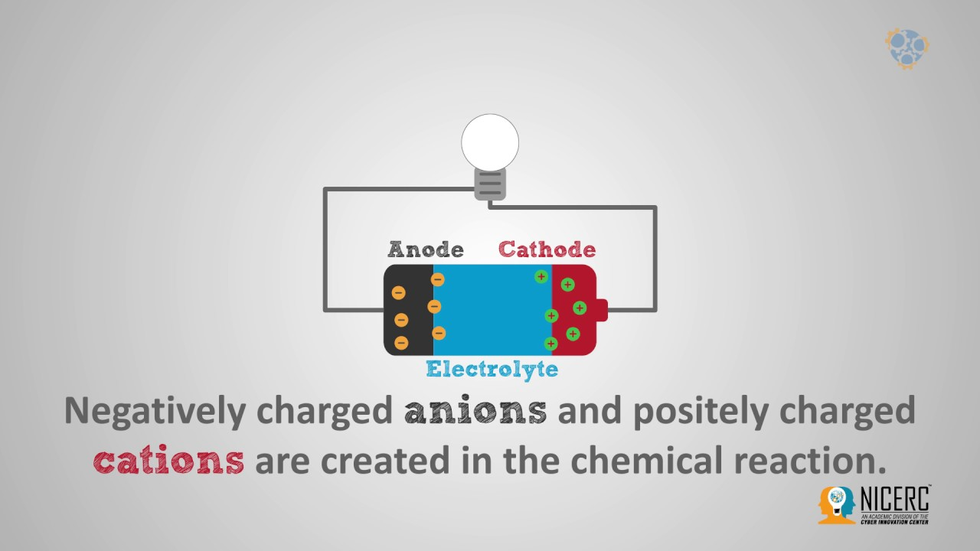
What is soil?

Slide 7
What is soil?

Slide 8
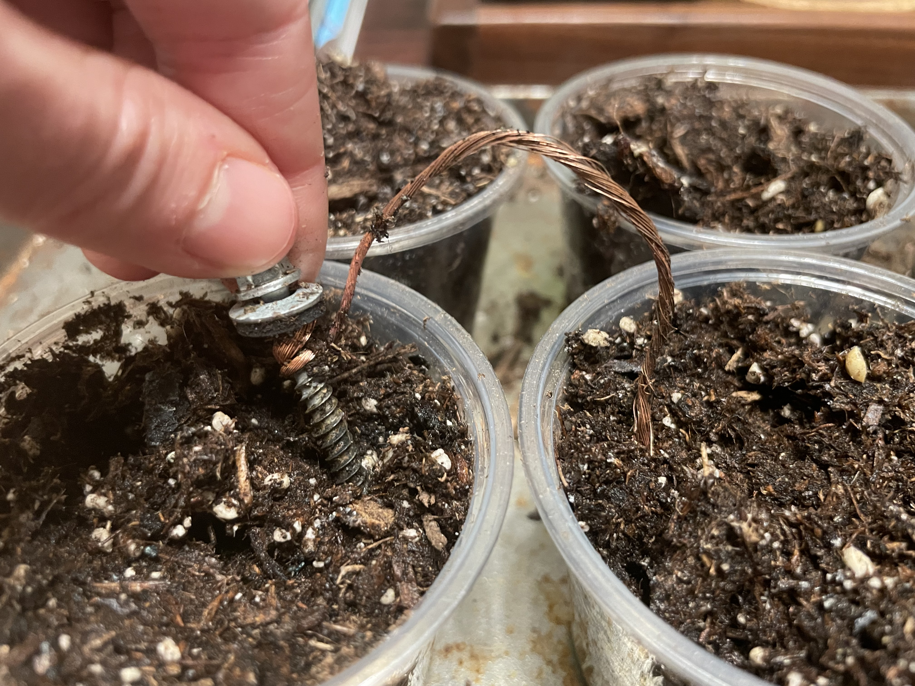
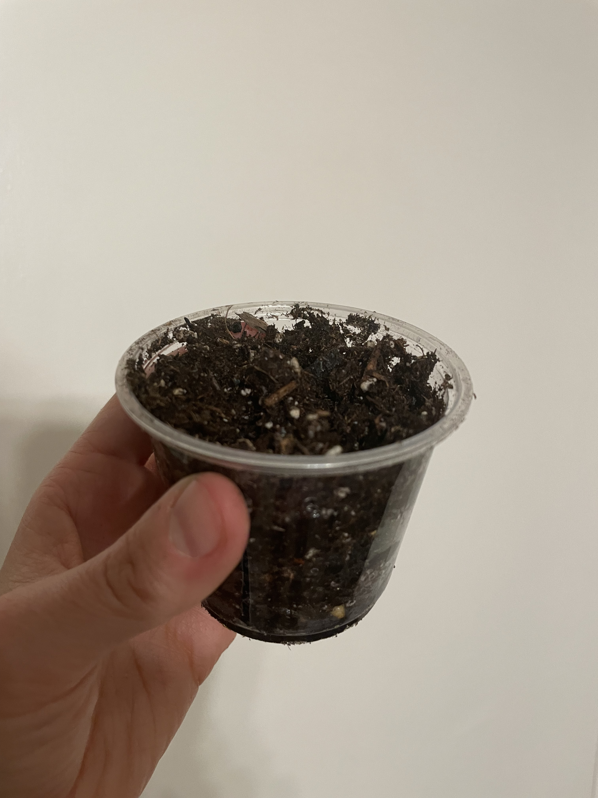
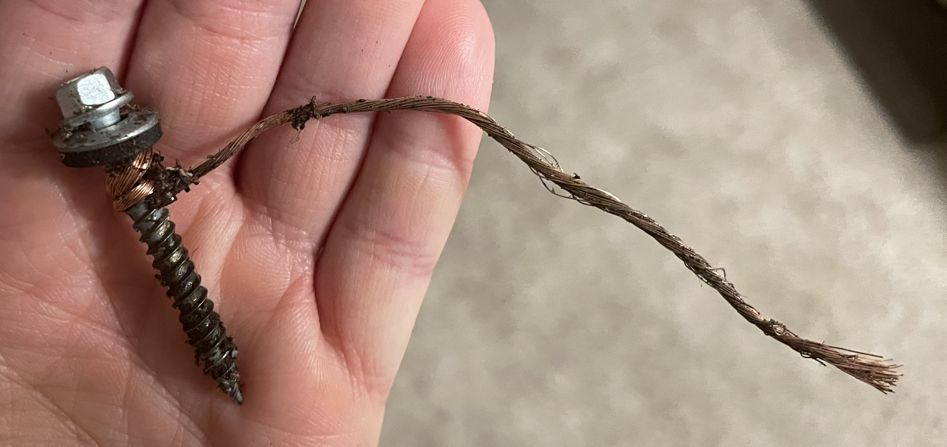
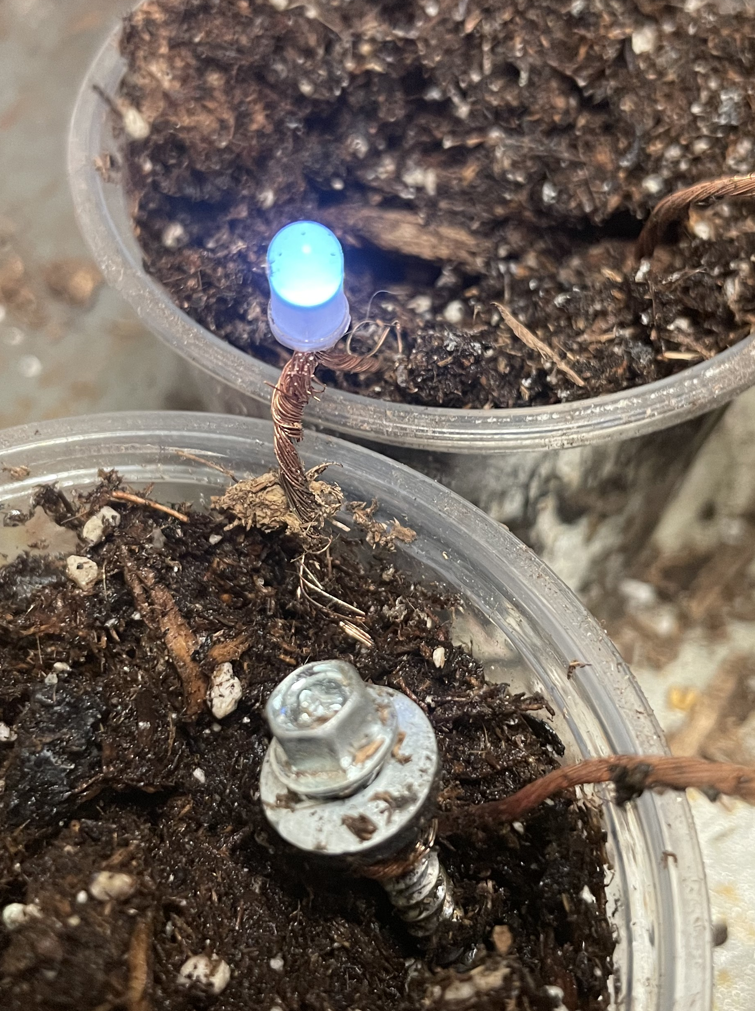
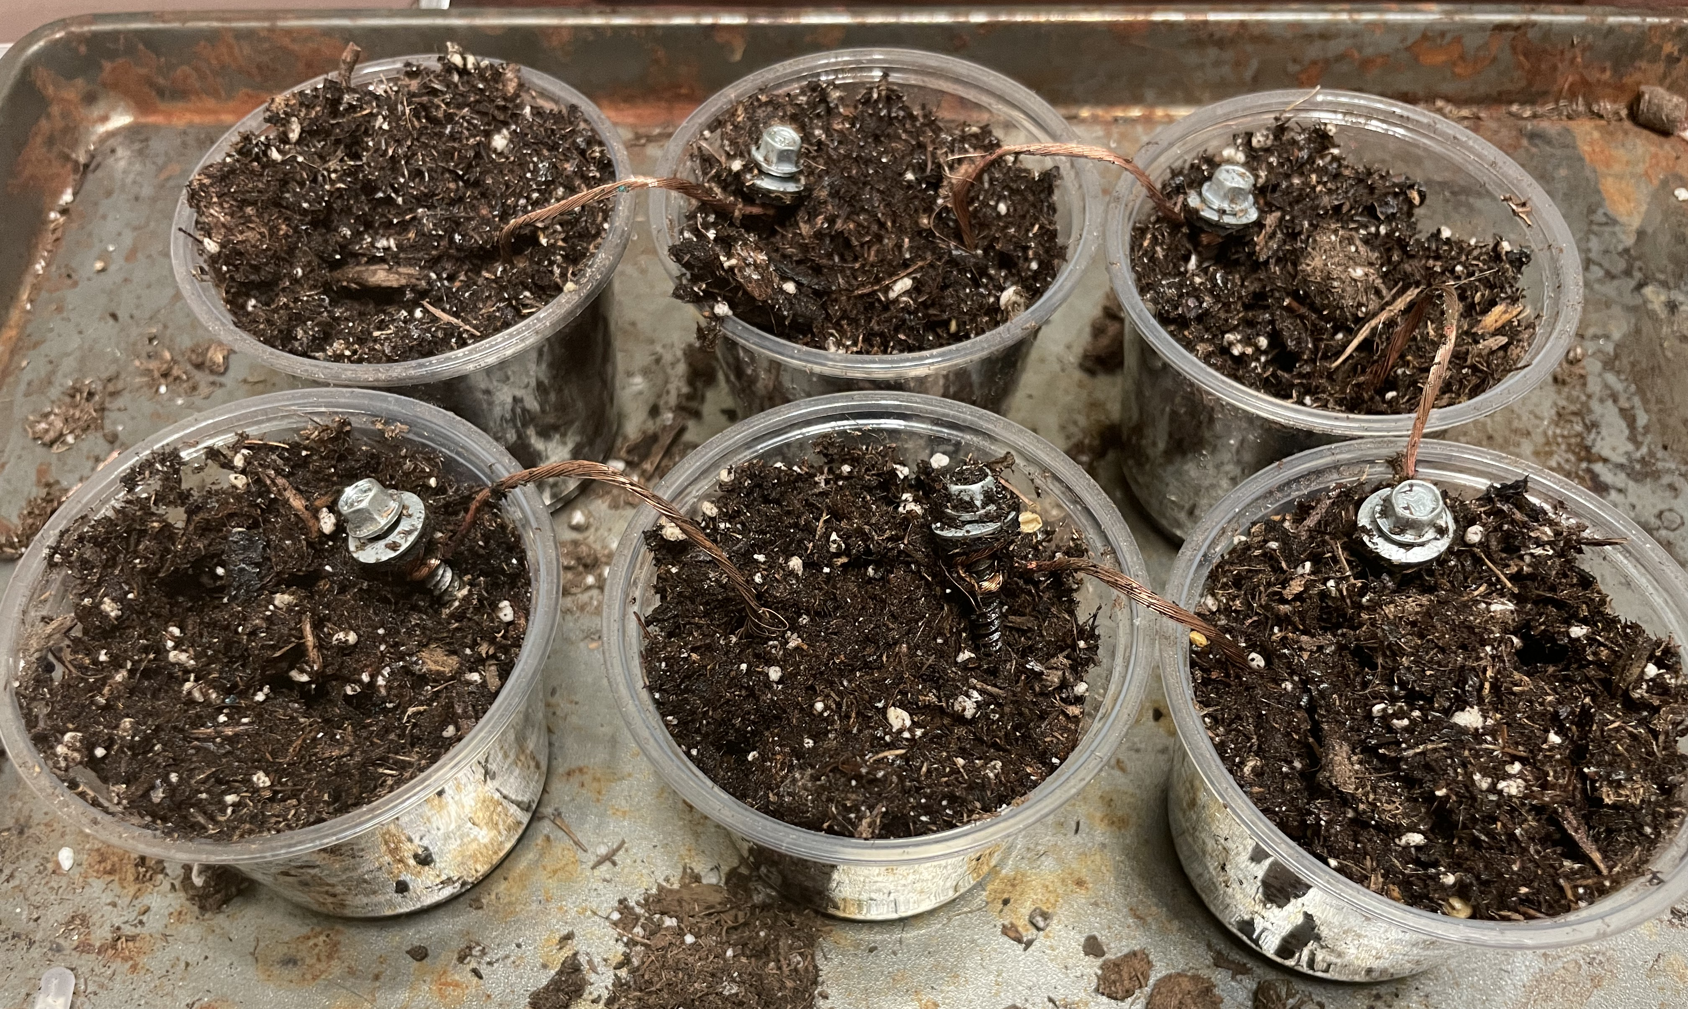
Steps to make a soil battery
1. Mix soil with water + vinegar until soil is wet.
2. Wrap a piece of copper wire twice around a metal screw.
3. Insert the screw in one cup and the copper wire in the next cup.
end
4. Repeat until you’ve gone all the way around, but don’t connect your end to your starting cup.
5. Insert light into starting and ending cup, watch it light up!
start

Slide 9

Where do we find batteries?

Slide 10






Where do we find batteries?
Everywhere!

Slide 11
How does a battery work?
Chemical energy stored through chemical reactions when battery not in use.
Electricity generated by movement of electrons when battery is connected to a device.
electrons
electrons

Slide 12

How does a soil battery work?
chemical energy
storage
soil
electrons

Slide 13
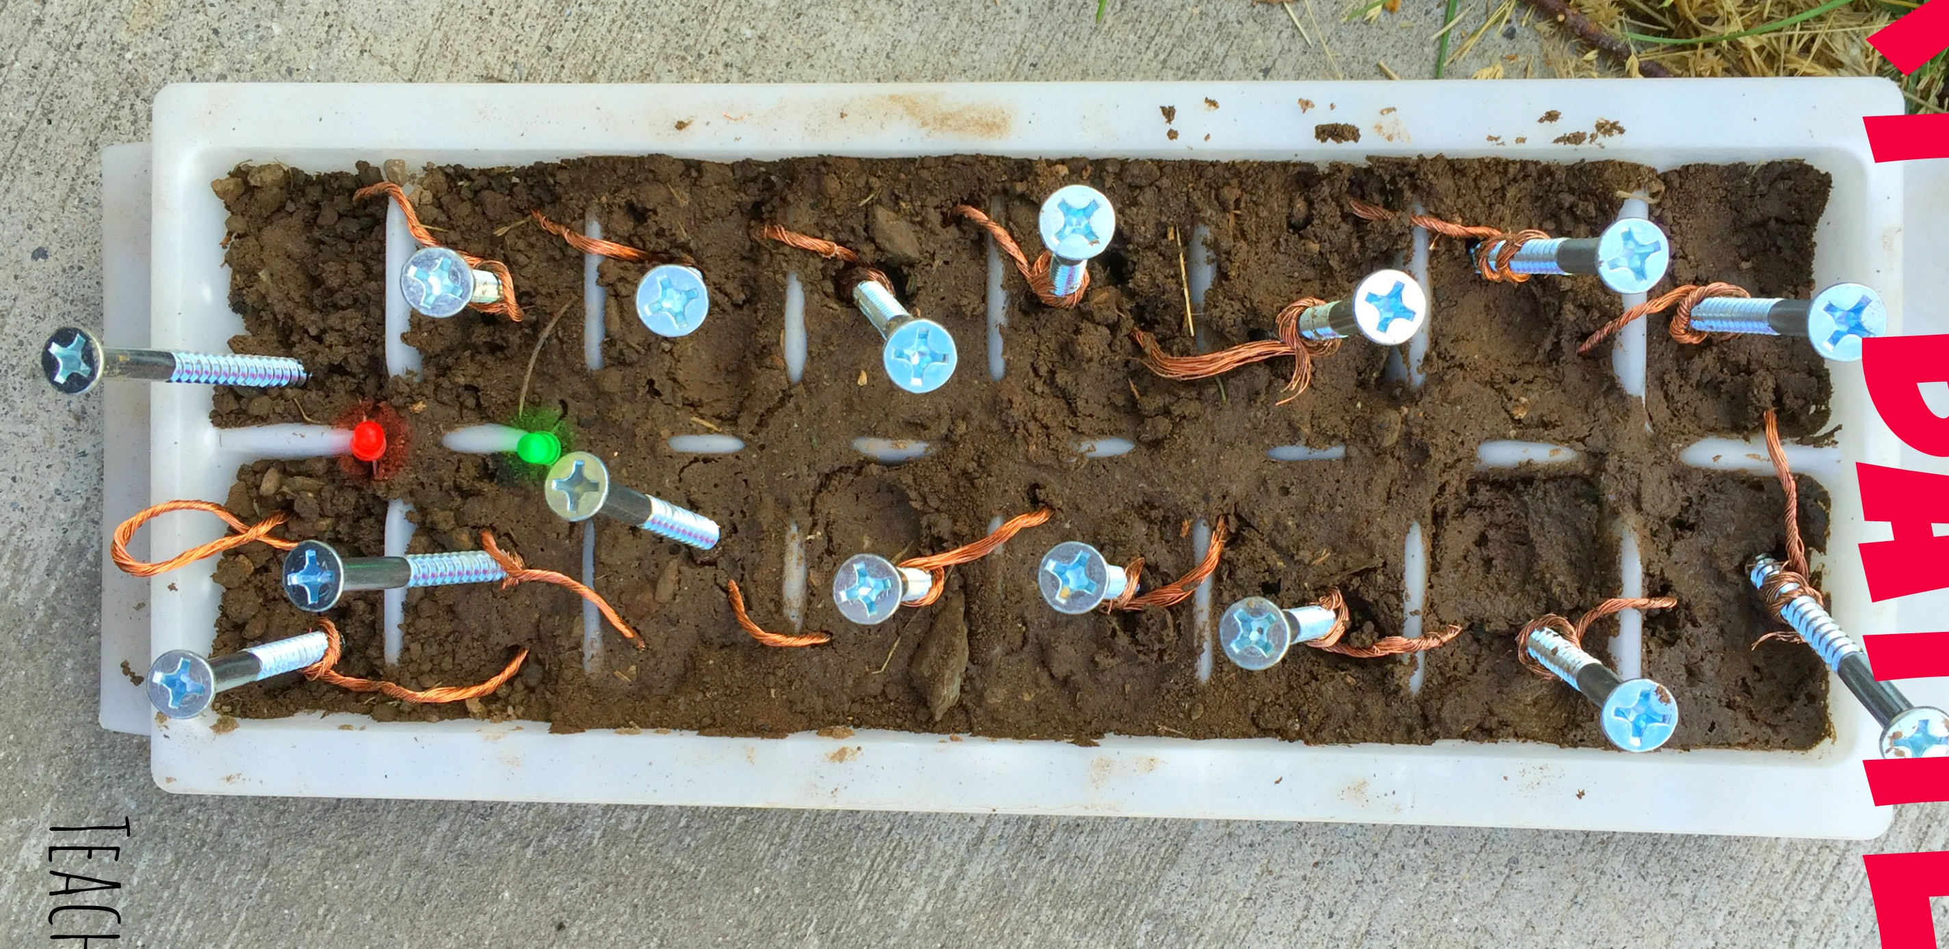
How does a soil battery work?
electricity
chemical energy
storage
soil
electrons
electrons
flow

Slide 14
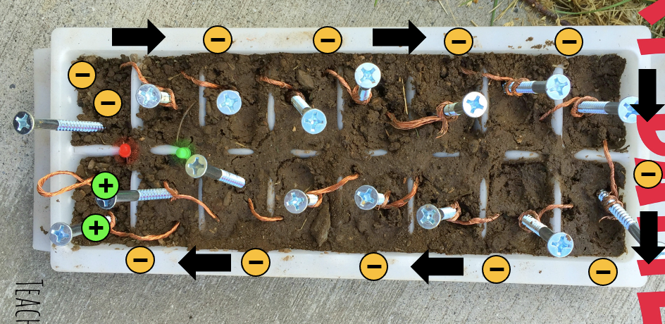
How does a soil battery work?
Our soil battery converts stored chemical energy into electricity when we build a path for electrons to flow.

